Slide 1
Course Title: Programming Fundamentals Course code: CSE 1113
Mohammad Hasan
Assistant Professor
Department of Computer Science and Engineering
Premier University

Slide 2
Computer Programming

Slide 3

Computer programming
Why programming?
Instructions and Program
Low level, High level and Middle level programming languages
Source Code and Object Code
Language Translators
Compiler
Interpreter
Assembler
Why language translators?

Slide 4
Difference between compiler and interpreter
Bug and Debugging

Slide 5
It is the process of giving instructions (commands) to the computer to do a meaningful task.
It is an act of teaching the computer on how to do a task.
The art and science of creating instructions for a computer to follow.
Creating a sequence of instructions to enable the computer to do something.

Slide 6






Slide 7

Computer is just a dumb machine made up of different electronic components. It is like a box which cannot do anything by itself.
It is the user who tells the computer “what it has to do?”
If we need our computer to perform some task, we first have to teach the computer in detail “how it will accomplish that task?”
Once the computer is taught about a particular task, it will completely obey it but cannot do anything that it is not taught to.

Slide 8
Like the humans, we can teach the computer through communicating with it using a particularlanguage.
The language that computer understands is machine language, also called as binary language. Machine language is the language of 0s and 1s.
We give detailed instructions to the computer to solve a particular task. Programming is the term that refers to teaching, instructing or giving commands to the computer.

Slide 9
Programming is more about problem solving skills than writing the code itself.
Programming teaches you how to understand, analyze and solve the problems. It enhances your analytical reasoning abilities and helps you cope with daily real life problems as well.
Hence learning to program is important because it develops analytical and problem solving abilities.

Slide 10


The person who gives the instructions (commands) to the computer is known as the programmer.
A person who designs and writes computer programs.

Slide 11



DOTHIS!

Slide 12

Instruction is any command given to the computer.
For example:
Add two variables Aand B
Display result
Read file
Each of these is the individual instruction to the computer.

Slide 13






NOWDO THIS! NOWDO THIS! NOWDO THIS! NOWDO THIS! NOWDO THIS!

Slide 14
Program is a set (collection) of instructions to do a meaningful task.
A sequence of instructions that are interpreted and executed by a computer.
It can be made of a single or hundred of instructions.
For example: In order to teach the computer on how to calculate average of three numbers? We need to give multiple instructions to the computer to do the task.

Slide 15
Instruction 1: Get first number from the user and store it in A variable Instruction 2: Get second number from the user and store it in B variable Instruction 3: Get third number from the user and store it in C variable Instruction 4: Add A, B, Cand store the result in SUM variable Instruction 5: Divide SUM by 3 and store result in AVGvariable Instruction 6: Display AVGvariable
Instructions 1-6 are used to solve a single task. This collection of instruction is known as a program.

Slide 16
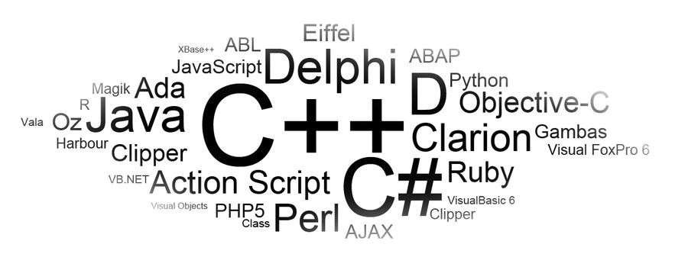

Slide 17
A programming language is an artificial language designed to communicate instructions to a computer.
A programming language is a notation for writing programs.
A vocabulary and set of grammatical rules for instructing a computer to perform specific tasks.

Slide 18
Each language has a unique set of keywords (special words that it understands) and a special syntax (format) for organizing program instructions.
There are many programming languages. For example:
COBOL
Pascal
C
C++
C#
Python
JAVA
PHP

Slide 19
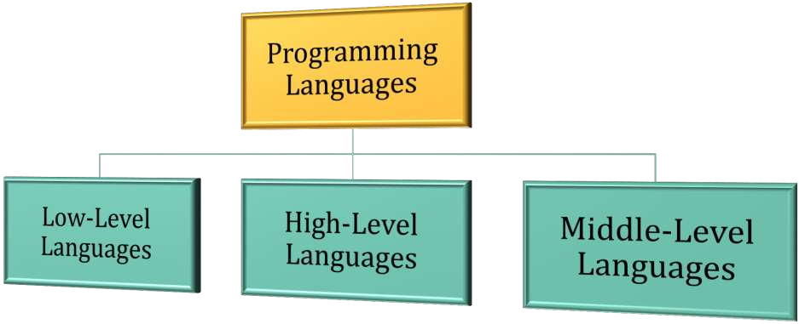
There are three types of programming languages:

Slide 20




Machine (Computer)
Human(Programmer)
LANGUAGE
A language which is closer to machine (computer)

Slide 21
A low level language is one which is closer to the machine (computer).
It is easier for machines to understand and difficult for humans to understand.
It is faster in execution as compared to high and middle level languages.

Slide 22

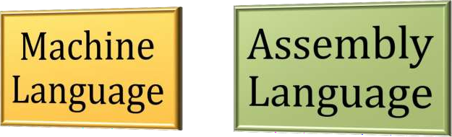
Two of the types of low level languages are:

Slide 23

It is one of the low level language.
It is the language of 0s and 1s.
Machine languages are the only languages directly understood by the computers.
While easily understood by computers, machine languages are almost impossible for humans to use because they consist entirely of numbers (0s and 1s).

Slide 24

It is the native language of the machines (computers).
Here all the instructions are written as code of binary sequence. For example:
In order to do addition, the code is: 10010001
In order to decrement a number by one, the code is: 11011011
In order to move data from one place to another, the code is:
 10000111

Slide 25

There are hundreds of instructions and each instruction has a binary code.
Is it possible to remember all the codes of hundreds of instruction?
Obviously not! Hence machine language almost impossible to understand.

Slide 26
Machine language program example:
10010010
11001010
01001010
11110101
00000101
00101000
11101010
10101010

Slide 27

Assembly language is same as machine language but uses English like words to represent individual operations.
For example: Instead of binary codes it uses : ADD, MOV,SUB, INC
Assembly language is also a low-level language.
It is easier than the machine language but still it is very difficult to control a larger program using assembly.

Slide 28

As assembly language contains English like words, which will not be understood by the computer (because it only understands 0s and 1s)
A translator first converts the assembly language program into machine language program.
Translator used with assembly language is called Assembler.

Slide 29

Assembly language program example:
MVI A, 05 h MVI B, 9A h ADD B
INC A
STA 8200h HLT

Slide 30


Machine (Computer)
Human(Programmer)
LANGUAGE
A language which is closer to human (programmer)

Slide 31
A high level language is one which is closer to the human (programmer).
It is easier for humans to understand and difficult for machines to understand.
It is slower in execution as compared to low level languages.

Slide 32
Like assembly language, it also uses English like words for the operations.
For example: for, if, else, break, continue, while, include, using, import
It is more easier than assembly language.

Slide 33
Some of the high level programming languages are:
GWBasic
C++
JAVA
Pascal
COBOL
Python
C#
Visual Basic
J#
Ruby
PHP

Slide 34
High level language programexample:
int main()
{
int | a | = | 5;
int | b | = | 6;
if(a > b)
cout<<“First number is greater.”;
else
cout<<“Second number is greater.”;
}

Slide 35

Machine (Computer)
Human(Programmer)
LANGUAGE
A language which is some how closer to machine as well as human

Slide 36
A middle level language is one which is closer to machine (computer) as well as to human (programmer).
A language that has the features of both low level and high level languages.
More formally, a high level language that allows you to write low level programs in it is called as middle level language.

Slide 37
Some of the middle level programming languages are:
C
IBMPL/S (Programming Language/Systems)
BCPL(Basic Combined Programming Language)
BLISS(Bill's Language for Implementing System Software)

Slide 38
Source Code
Source Code and Object Code
Object Code
The set of instructions written in machine language is called as object code. It is also known as machine code.
The set of instructions written in any language other than machine language is called as source code.
It is not directly understood by the machine (computer).
It is the only code which is directly understood by the machine (computer).

Slide 39
Source Code
Source Code and Object Code
Object Code
It is in the form of binary numbers.
It is in the form of text.
It is human readable.
It is generated by human (programmer).
It is input to the language translator.
It is machine (computer) readable.
It is generated by the language translator.
It is the output of the language translator.

Slide 40


Slide 41

Language translator is a program that converts the source code into the object code.
Translator
Source Code
CONVERT
Object Code
Language Translator

Slide 42
Computer only understands object code (machine code).
It does not understand any source code.
There must be a program that converts source code in to the object code so that the computer can understand it.
The language translator is one which does this job.
The programmer writes the source code and then translator converts it in machine readable format (object code).

Slide 43
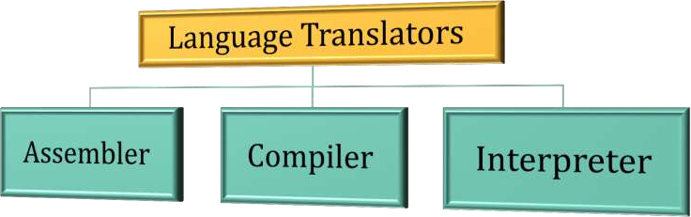
There are three types of language translator:

Slide 44

Assembler is the language translator that converts assembly language code in to the object code (machine code).
Assembler
Assembly Source Code
CONVERT
Object Code

Slide 45

Compiler is the language translator that converts high level language code in to the object code (machine code).
It converts the whole code at a time.
Compiler
High-Level Source Code
CONVERT
Object Code

Slide 46





Program
Read whole Program
Line 1 : Instruction 1
Line 2 : Instruction 2
Line 3 : Instruction 3
Line 4 : Instruction 4
Line 5 : Instruction 5
Line 1 : Instruction 1
Line 2 : Instruction 2
Line 3 : Instruction 3
Line 4 : Instruction 4
Line 5 : Instruction 5
Convert whole program in to object code
Execute
1
2
3
4

Slide 47

Interpreter is the language translator that converts high level language code in to the object code (machine code).
It converts the code line by line.
Interpreter
High-Level Source Code
CONVERT
Object Code

Slide 48












Program
Line 1 : Instruction 1
Line 2 : Instruction 2
Line 3 : Instruction 3
Line 4 : Instruction 4
Line 5 : Instruction 5
2
Read Line 1
Read Line 2
Convert in to object code
Convert in to object code Convert in to object code Convert in to object code Convert in to object code
Execute
Execute 3
Read Line 3
Read Line 4
Read Line 5
Execute
Execute Execute
4
5
6
1

Slide 49

No | Compiler | Interpreter
1 | Compiler Takes Entire program as input | Interpreter Takes Single instruction as input .
2 | Intermediate Object Code is Generated | No Intermediate Object Code is Generated
3 | Executes faster | Executes slower
4 | Memory Requirement : More (Since Object Code is Generated) | Memory Requirement is Less
5 | Program need not be compiled every time | Every time higher level program is converted into lower level program
6 | Errors are displayed after entire program is checked | Errors are displayed for every instruction interpreted
7 | Example : C , C++, C# | Example : Python, Ruby, Perl

Slide 50


Bug

Slide 51

An error or defect occurred inside a computer program or hardware that causes it to produce an incorrect or unexpected result, or to behave in unintended ways is called as a bug.
Most of the bugs arise from mistakes and errors made by programmer in sourcecode.

Slide 52
The term bug was used by Grace Hopper in 1946.
Hopper used to work on Mark II computer, there some error occurred in the system. The cause of the error was a moth (bug) trapped in a relay creating short circuit.
That caused the term bug to be coined.

Slide 53



Slide 54

It is the process of finding and fixing the bugs (errors) in the program.
It is the process of removing errors.
The programmer manually does this by examining the source code.

